Slide 1
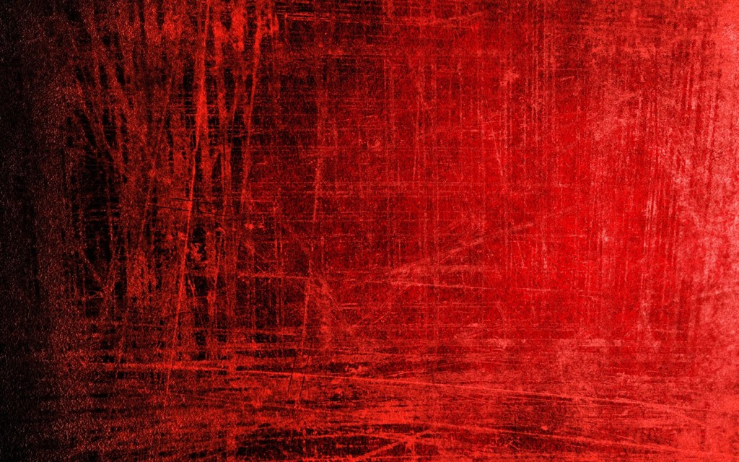

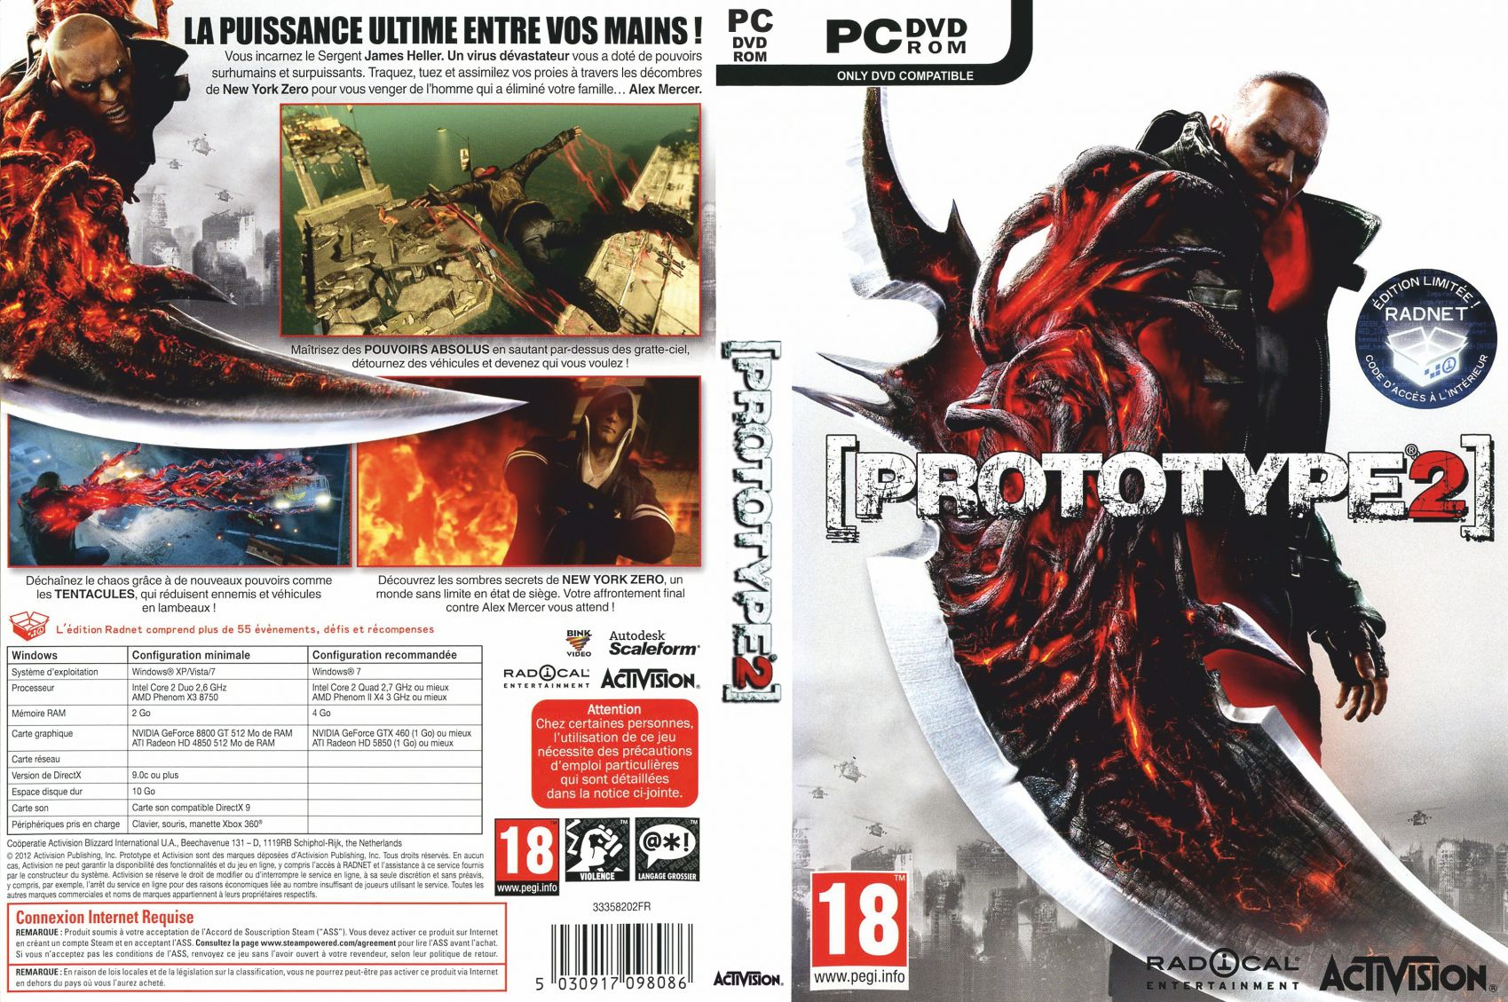
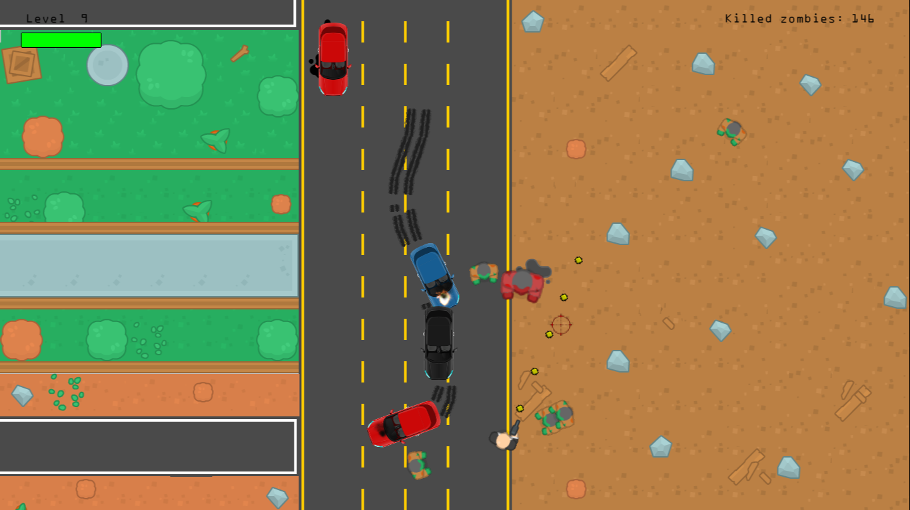
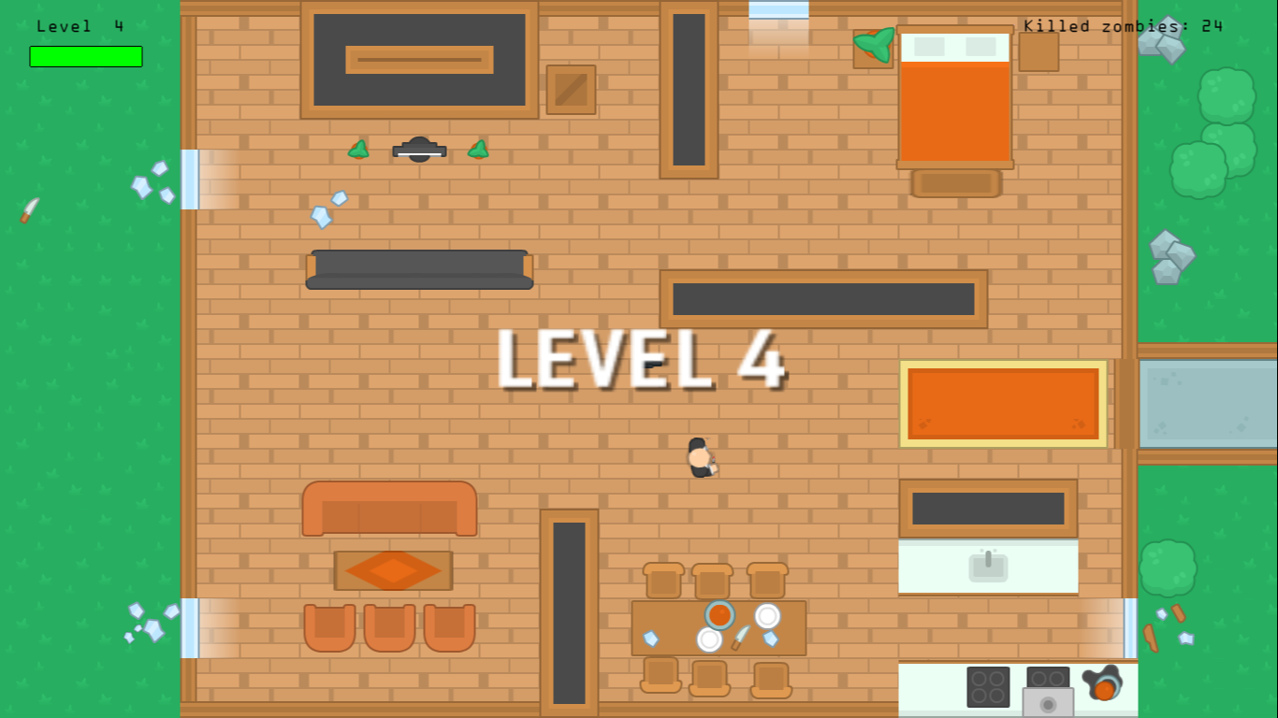

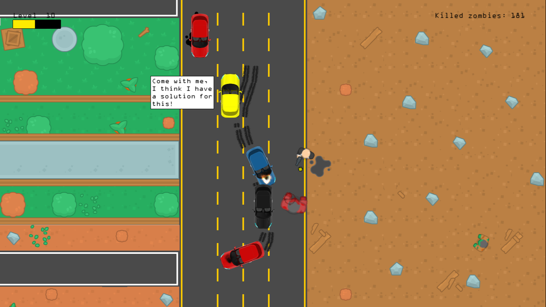
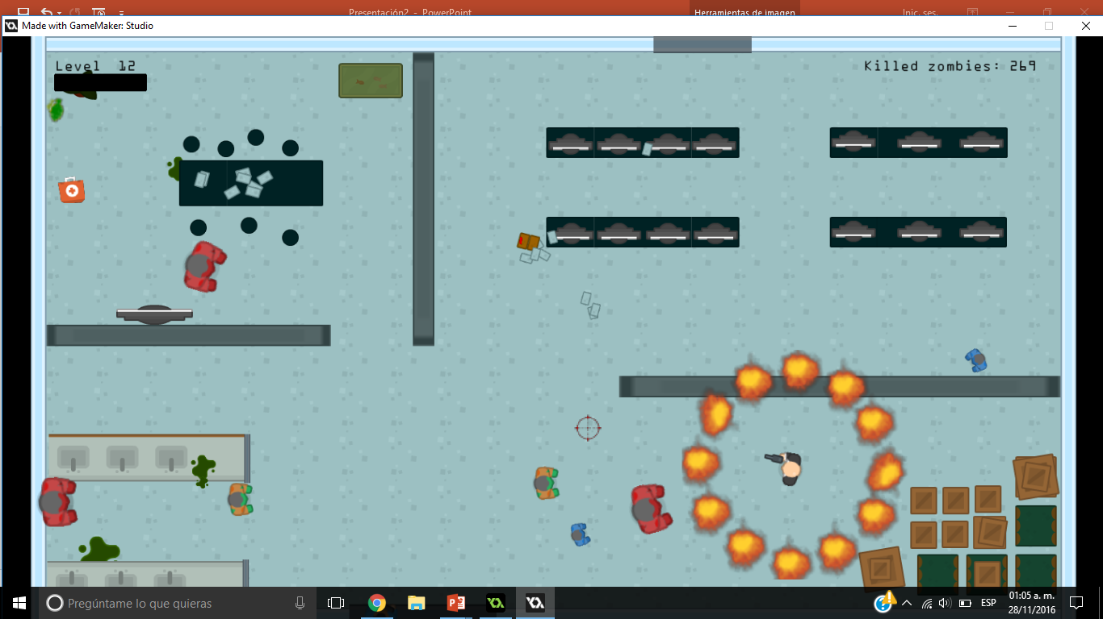




Play as a man trained to mutilate zombies
Go through different levels looking for survival
You are not alone!
Shootings, explosions and more!
PC
1 player
Mouse recommended
Developed in Game Maker: Studio. Used Kenney’s top-down shooter assets and new developed sprites.
Requires DirectX 8 or later and Windows XP or later. Read instruction booklet for more information.
Diego Mtz – Hector de Luna – Luis Bravo
Rafael Serna – Arturo Torres

